Slide 1

Sivadeep kotha :B00116695
Venkat sai sheelam :B00116394 professor : Venkata Anga
Vineela pedapudi :B00115516

Slide 2
INTRODUCTION
Over the past year of study, the news on information security and financial fraud as it is essential to all online and offline financial transaction systems.
Although fraudulent transactions account for a relatively small percentage of most medium credit card transactions.
The Credit card fraud can easily accomplish their purpose Large amounts of money can transact in a short period without any indication of risk and the owner's permission.

Slide 3
DEFINITION
A credit card fraud detection project involves using data and statistical models to spot fraudulent credit card transactions
collect transaction details like distance from home, distance from last transaction, repeat retailer, used chip, online order
clean and prepare the data by handling missing values and outliers.

Slide 4
OBJECTIVES
We have to investigate current credit card fraud detection system
Analyze existing datasets to extract relevant information
Utilize oversampling and under-sampling techniques to solve the problem of highly unbalanced credit card data sets faced by the current fraud detection system.
.

Slide 5
SCOPE
Fine-tune models to catch more instances of credit card fraud
Experiment with sampling techniques to handle class imbalance.
The data has already been anonymized and doesn't contain any personal identifiable information.
Fraud patterns are expected to evolve over time hence models need periodic retraining.

Slide 6
EXISTING SYSTEMS
Credit card fraud detection systems typically use established methods like regression analysis and machine learning models such as Naive Bayes, Decision Trees, K-Nearest Neighbors, Logistic Regression, and Random Forest.
However, they encounter challenges due to an imbalance in credit card datasets, which can result in both false positives and false negatives.
To address this, techniques like SMOTE (Synthetic Minority Over-sampling Technique) are employed to balance and enhance the dataset for more effective fraud detection.

Slide 7
PROPOSED SYSTEM
In order to overcome these constraints and improve credit card fraud detection efficiency, the suggested system presents an all-encompassing and optimal methodology.
Enhanced Sampling Techniques:
Implementing SMOTE (Synthetic Minority Over-sampling Technique) to address class imbalance in credit card datasets.
2. Diverse Machine Learning Models:
Utilizing a diverse set of machine learning models, including Naive Bayes, Decision Trees, K-Nearest Neighbors, Logistic Regression, and Random Forest.
3.Feature Selection for Model Optimization:
Conducting feature selection based on the importance for each machine learning model.

Slide 8
PROPOSED SYSTEM
4. Continuous Monitoring and Retraining:
Recognizing the dynamic nature of fraud patterns, the proposed system emphasizes the importance of continuous monitoring and periodic retraining of models.
5. Mitigating Disadvantages:
Regularly update and retrain the machine learning models to adapt to evolving fraud patterns, ensuring the system remains effective over time.

Slide 9
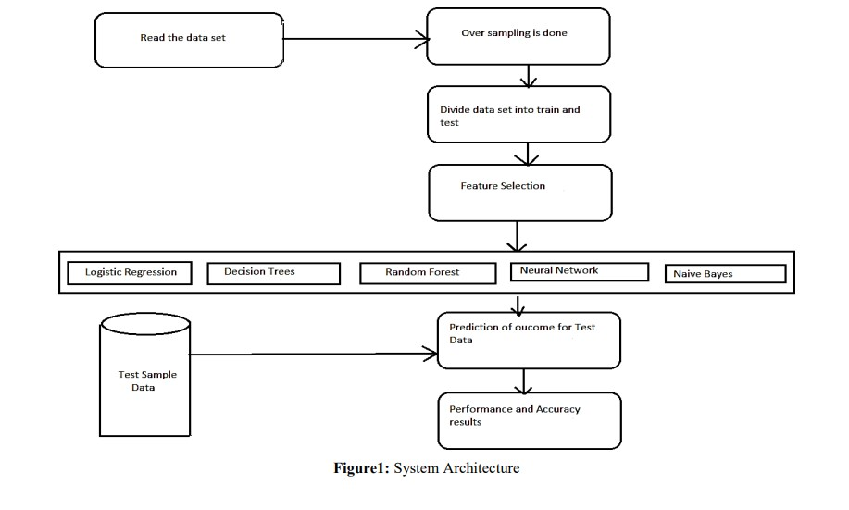
System Architecture

Slide 10
METHODS AND TECHNIQUES
Working with a fraud detection dataset. They are some main methods and steps used
Data Loading and Exploration: Used Pandas to load the dataset.
Displayed the first few rows of the dataset and provided a summary using info().
Generated histograms and descriptive statistics to explore the data.
Data Resampling using SMOTE: Used the Synthetic Minority Over-sampling Technique (SMOTE) to handle class imbalance in the target variable ("fraud").
Machine Learning Models: Naive Bayes
Decision Tree
K-Nearest Neighbors
Logistic Regression
Random Forest
Feature Selection: Selected specific features based on importance for Naive Bayes, Decision Tree, and K-Nearest Neighbors models.

Slide 11
ADVANTAGES
Preventing financial
Protecting customer data
Maintaining customer trust and loyalty
Early Detection of Anomalies

Slide 12
DISADVANTAGES
False positives
Implementation costs
Learning period
Transaction declination
Resource intensive

Slide 13
CONCLUSION
This research is all about studying credit card fraud-detection models based on different machine learning classification algorithms. The goal is to be in this training and testing. To find out the best way to process the dataset and the best machine learning classification algorithm for the dataset of this credit card transaction.
So to achieve this, we chose five different classifiers, respectively. Between them, 7 different combinations of algorithms and sampling methods were used to evaluate their predicted performance as a way to get better results for credit card fraud detection

Slide 14
REFERENCE
1.Alireza Agha Mohammadi and Mohammad Kachuee. "Credit Card Fraud Detection Using a Convolutional Neural Network." IEEE Access (2018).
2. Rong Duan and Hongyu Wu. "Credit Card Fraud Detection Using Random Forest Algorithm." In Proceedings of the International Conference on Computational Intelligence and Security (CIS), 2012.
3. R. Mahmood, et al. "Credit Card Fraud Detection: A Realistic Modeling and a Novel Learning Strategy." IEEE Transactions on Neural Networks and Learning Systems (2013).
4. Fabio M. Carlucci, et al. "Credit Card Fraud Detection and Concept-Drift Adaptation with Delayed Supervised Information." Expert Systems with Applications (2015).
5 LI Changjian, HU Peng: Credit Risk Assessment for ural Credit Cooperatives based on Improved Neural Network, International Conference on Smart Grid and Electrical Automation vol. 60, no. - 3, pp 227-230, 2017.
6 Wei Sun, Chen-Guang Yang, Jian-Xun Qi: Credit Risk Assessment in Commercial Banks Based On Support Vector Machines, vol.6, pp 2430-2433, 2006

Slide 15

Thank you

